Slide 1

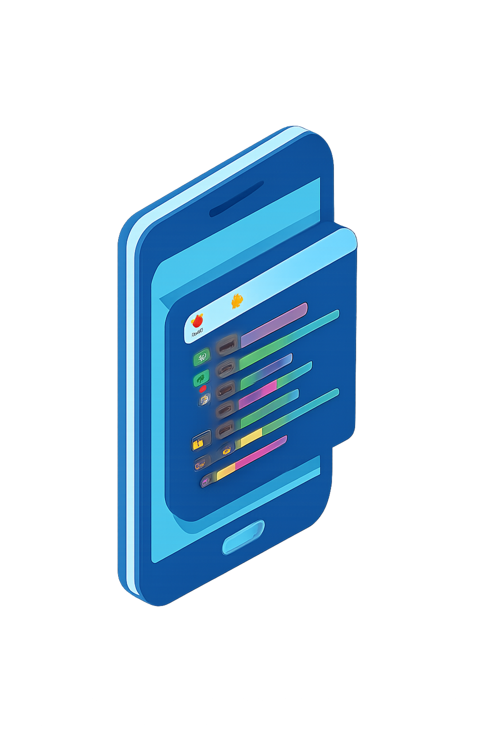
Mobile App Development Internship
Code IT Student Portal – Cross-Platform Flutter App
Manish Shrestha | PU Reg. No: 2022-1-07-0141
Code IT, Dharan | Pokhara Engineering College
April 12 – July 12, 2026

Slide 2

ABOUT THE COMPANY
Introduction to Code IT
EdTech organization established in 2017 in Dharan, Sunsari
Mission: "Quality Education Without Financial Barriers"
200+ enrolled students on the learning platform
Internship goal: Migrate web-based Student Portal to a native mobile app
Internship duration: April 12,2026 to July 12, 2026

Slide 3
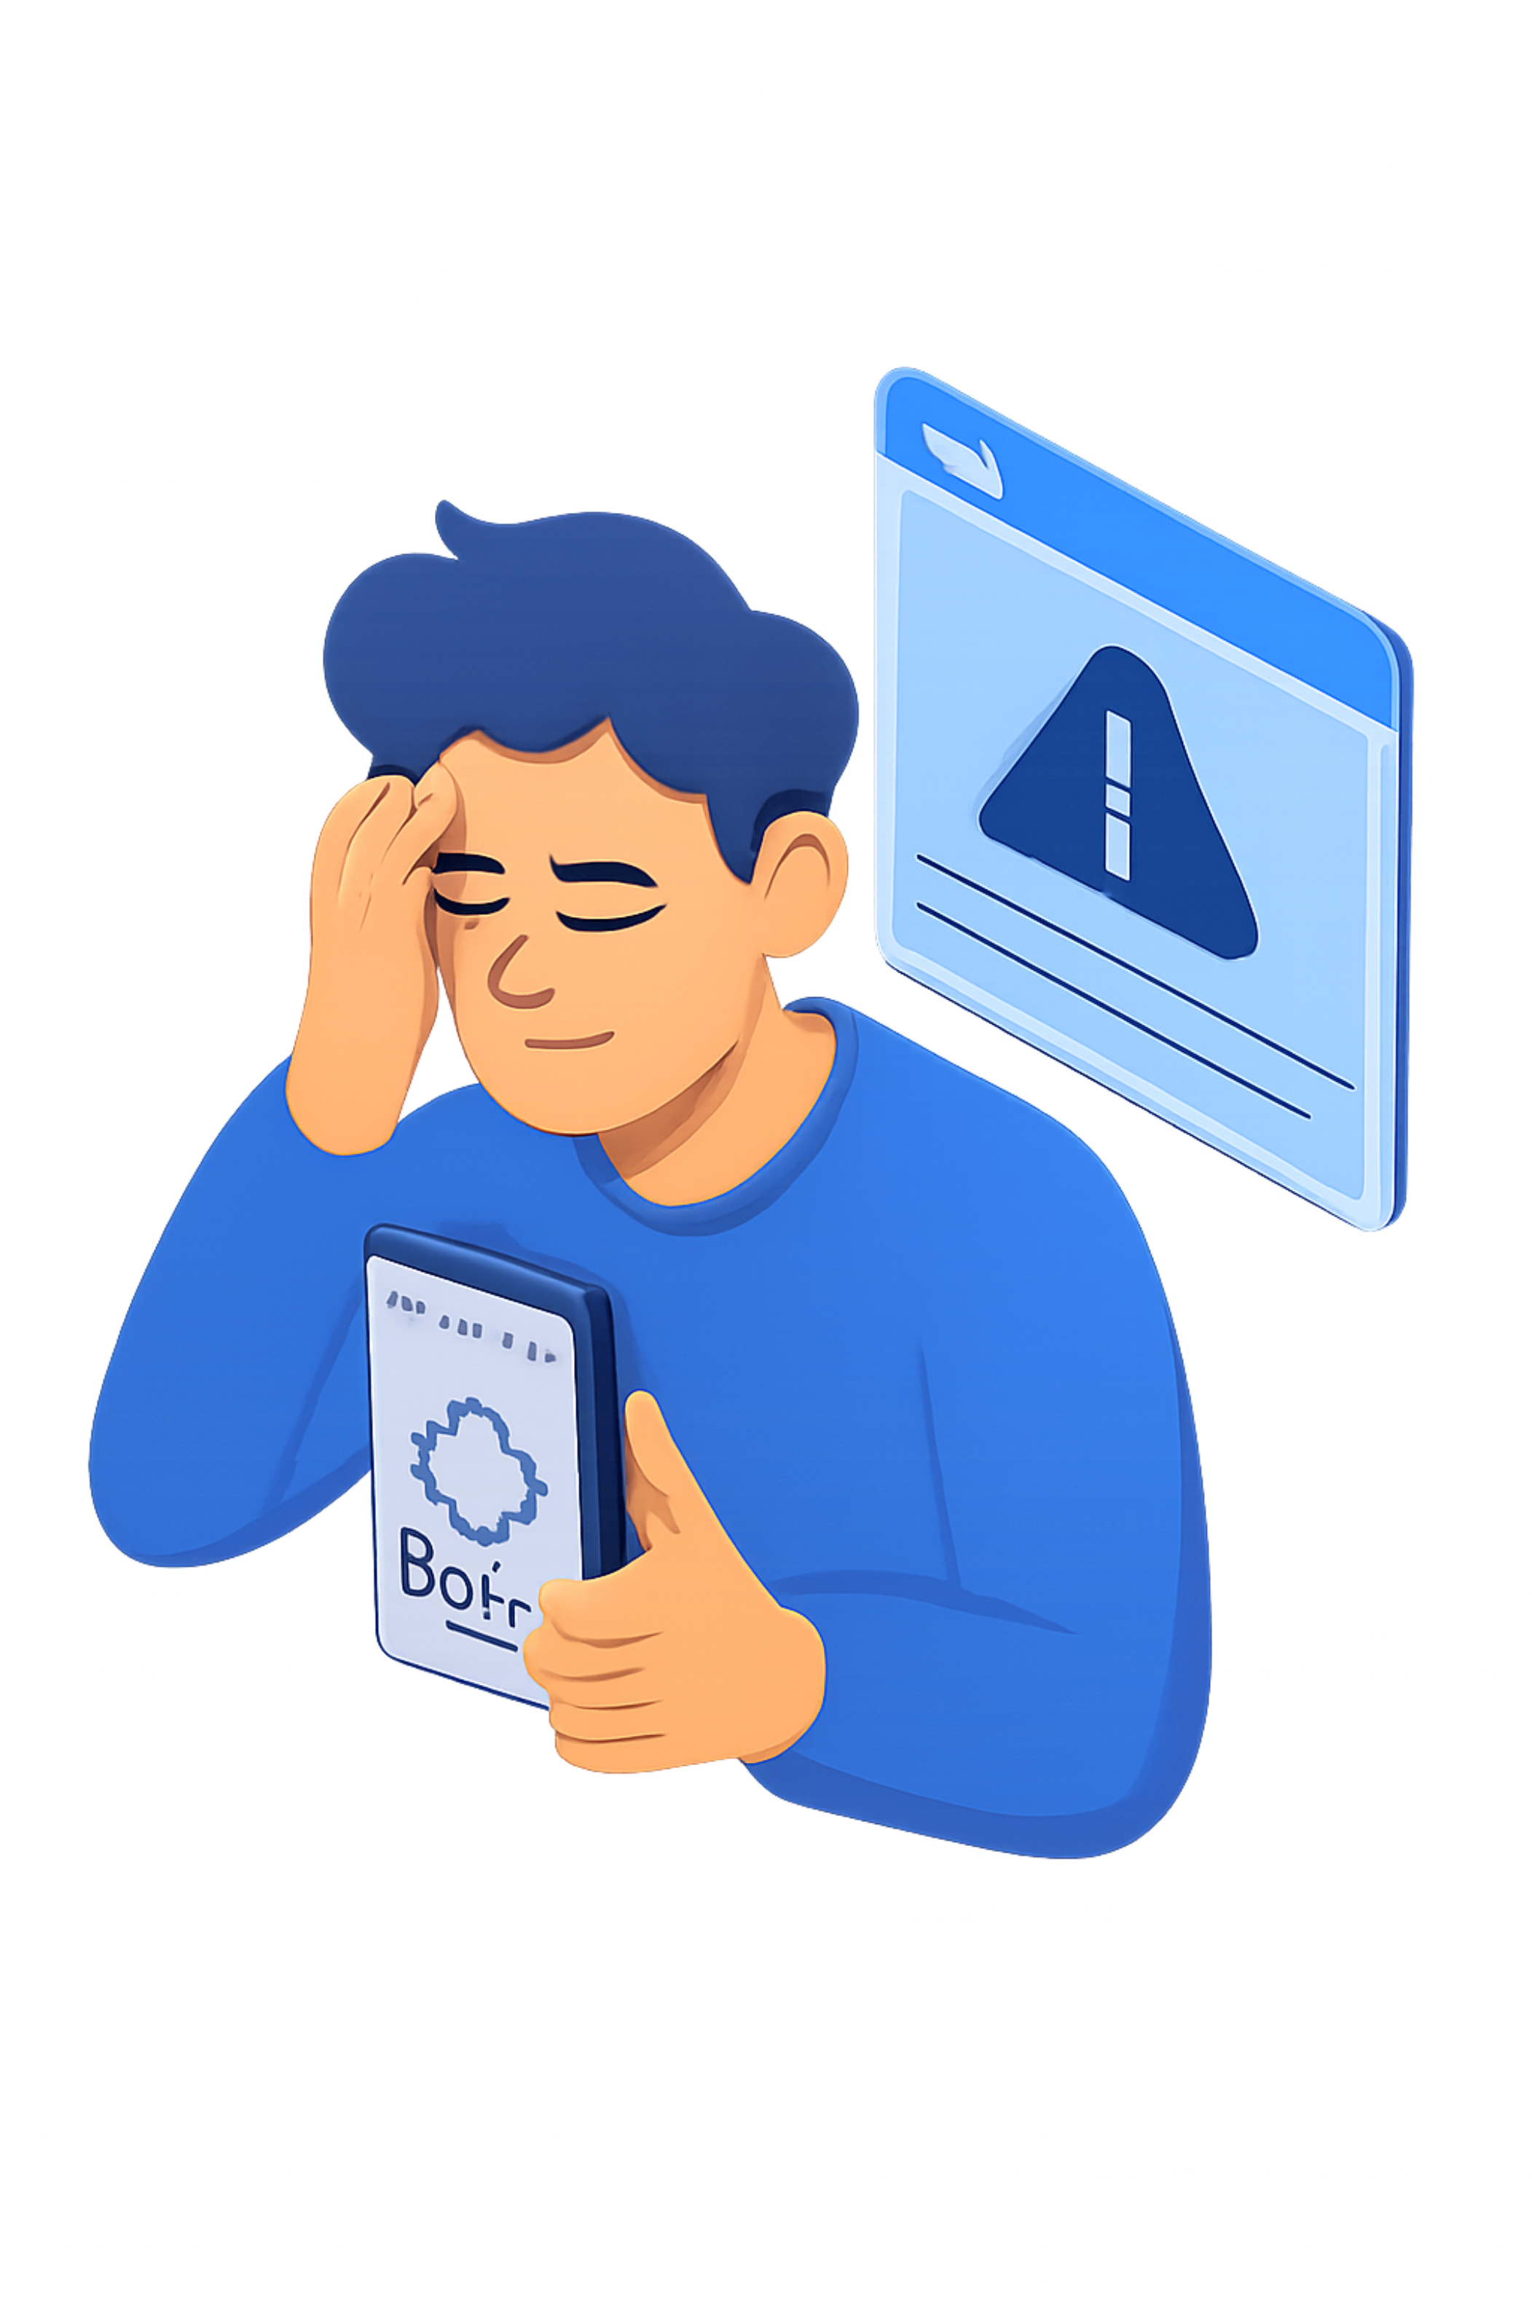
Problem Statement
Poor Mobile UX
Web-only portal with UI formatting inconsistencies on mobile browsers
No Native Features
Missing push notifications, biometrics, and offline mode
Low Performance
Poor performance on using on mobile browsers
Student Needs
On-the-go access to courses, live classes, and certificates

Slide 4
Objectives
1
Cross-Platform App
Develop Android & iOS app using Flutter & Dart
2
API Integration
Integrate RESTful APIs with MVCS architecture
3
Biometric Security
Implement Fingerprint / Face ID authentication
4
Enrollment Module
Build Course Enrollment with payment verification
5
Professional Growth
Gain experience in remote agile development

Slide 5
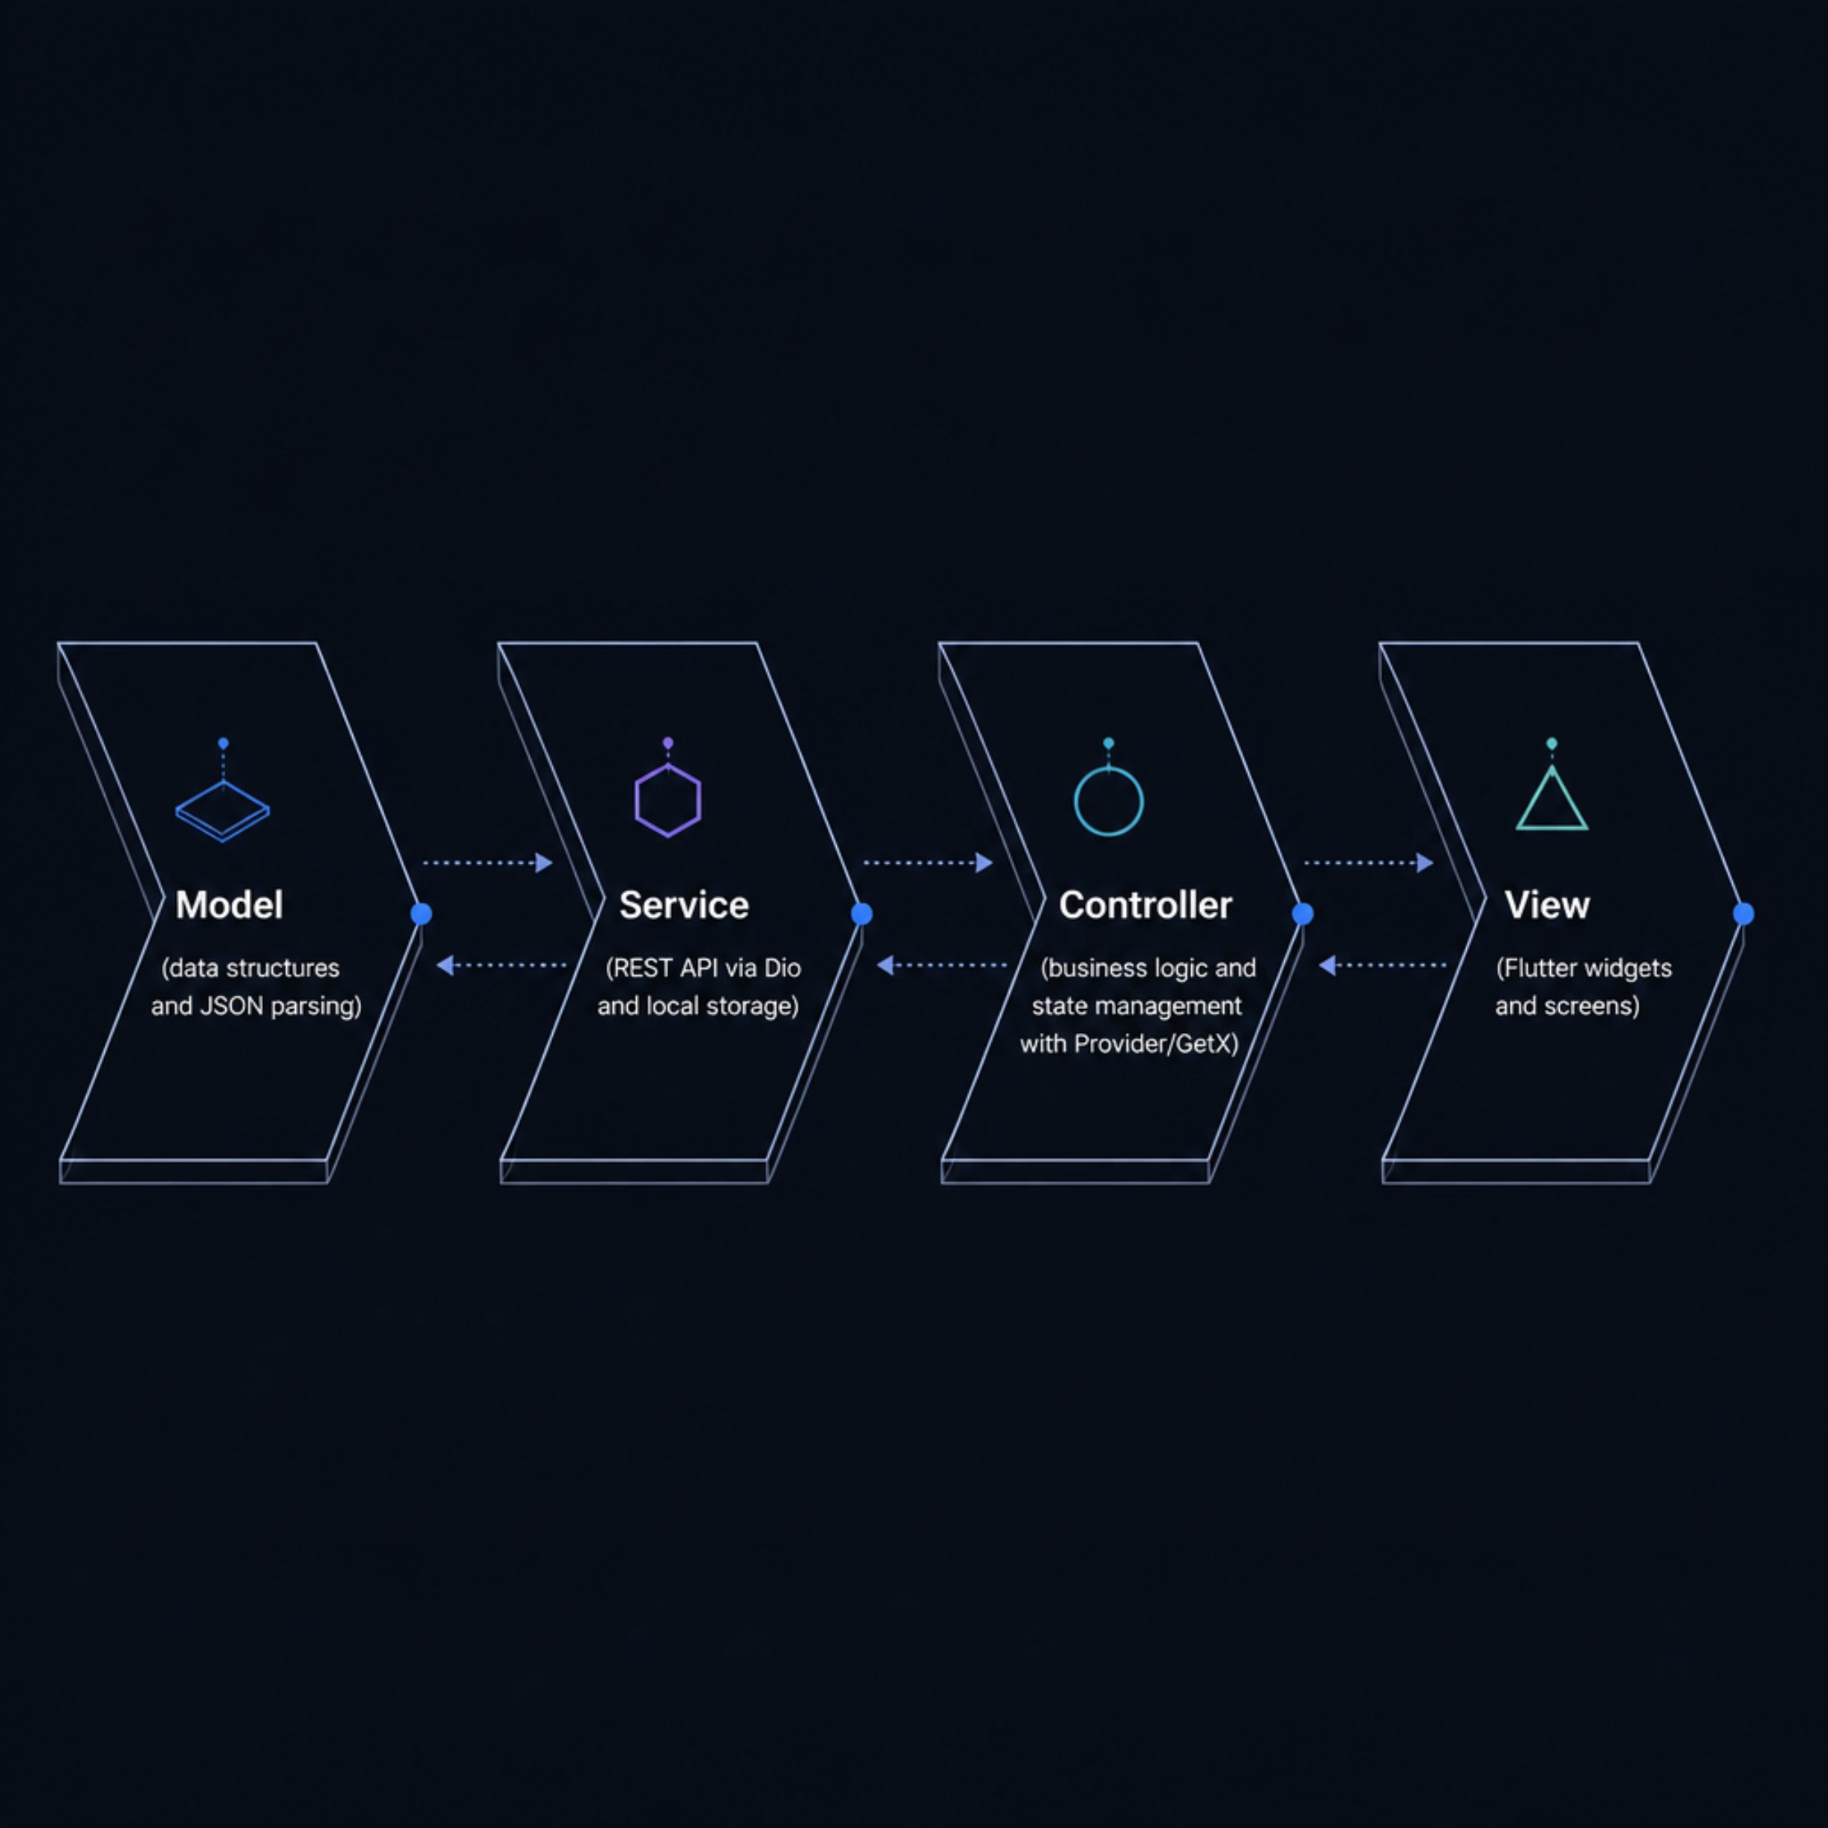
ARCHITECTURE
System Architecture – MVCS Pattern
Flow: Model ↔ Service ↔ Controller ↔ View
Model: Data structures & API response parsing (JSON)
View: Flutter widgets — Screens, Pages, Custom Widgets
Controller: Business logic & state management (GetX)
Service: REST API calls via Dio + local storage

Slide 6
Core Features Delivered
Authentication
Dashboard
Support
Login, OTP, Password Reset, Biometric Login
Live classes, courses, receipts, certificates
Ticketing: Technical, General, Counseling and Internship
Courses
Certificates
Course Purchase
Video player, recorded classes, notes download
User can email the certificates in their email.
User can purchase the course.

Slide 7
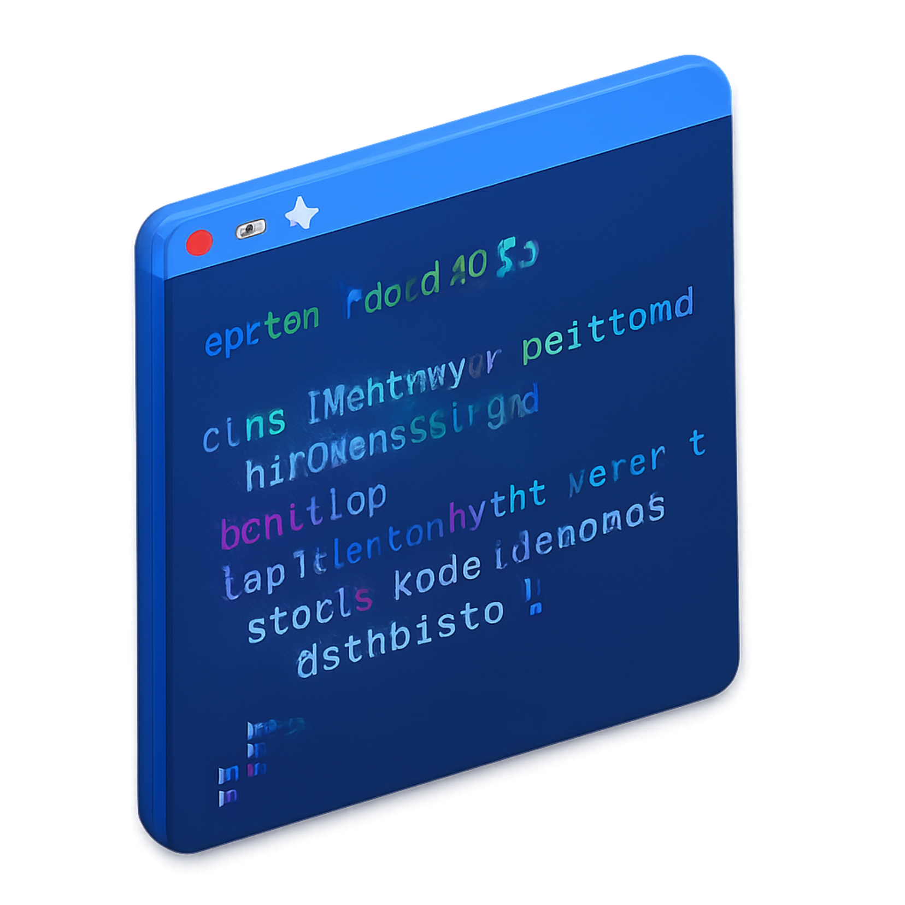
TECH STACK
Technologies Used
Frontend
HTTP & State
Security
Flutter & Dart (cross-platform UI)
Dio (interceptors) · Provider · GetX
local_auth ^3.0.1 — biometric authentication
Media & Network
Dev Tools
Figma · Postman · GitHub · Vscode
image_picker ^1.2.2 · connectivity_plus ^7.1.1

Slide 8
Key Technical Highlights
Week 4
1
Complete UI rebuild to match company Figma design system
2
Week 10
Design pivot: 3D buttons → modern flat design
Responsive UI
3
LayoutBuilder & MediaQuery — to make the UI responsive and fixed all overflow errors in small devices.
4
Biometric Auth
Added Fingerprint & Face ID login
Offline Checker
5
Added offline checker so students know when internet is gone

Slide 9
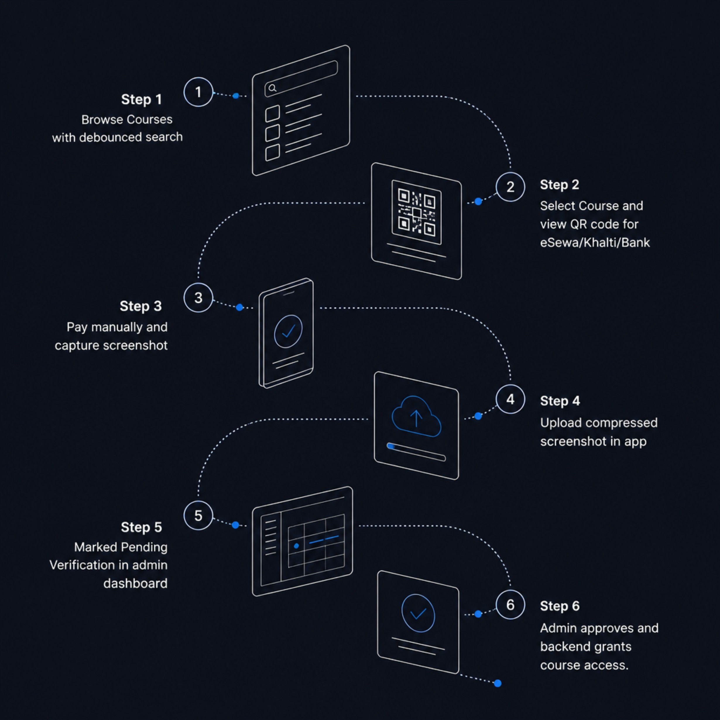
ENROLLMENT FLOW
Course Enrollment & Payment Flow
A 6-step manual verification flow supporting eSewa, Khalti, and Bank transfer:
Student browses courses using debounced search
Selects course → static QR code displayed (eSewa / Khalti / Bank)
Pays manually → captures payment screenshot
Uploads screenshot in app — automatically compressed
Flagged as "Pending Verification" in admin dashboard
Admin approves → backend grants course access

Slide 10

QA Collaboration & Bug Resolution
QA Activities
Resolved 12+ Edge-Case Bugs
Assisted QA team with Postman setup and Flutter environment
Distributed APK builds for real-device testing
Conducted app walkthrough sessions for non-developer stakeholders
Full regression testing before final handover
Auth loop → Dio token refresh interceptor
Sorting crash → null-safety checks
Duplicate downloads → unique file naming
Text overflow → TextOverflow.ellipsis
Offline detection → connectivity_plus global listener

Slide 11
Conclusion
100%
80%→100%
Project Complete
Progress
Bug-free build submitted July 12, 2026
Midterm to final — Transaction Module, Offline Detection, Bug Fixes
LEARNING OUTCOMES
Skills Acquired
Flutter & Dart Proficiency
MVCS Architecture & APIs
Production-grade cross-platform mobile development
Clean separation of concerns with RESTful integration
Native Device Integration
Remote Agile Collaboration
Biometrics, image picker, and network connectivity
Regression testing & professional handover

Slide 12
Thank You

